Slide 1
User Interface

Slide 2
Requirements
Interface show result.
Show detail about point that measure such as pass or fail.
Adjust value such as R max, R min.
Adjust number of points that has to be measure.
Export file (.txt).

Slide 3
UI Desing Draft
Main
Setting
Main
Setting
Point x
X
Ω
Ω
Resistance
OK/NG
Point 1
X
Point 2
X
Ω
Tolerance
X
Ω
…
…
Point n
X
Ω
Point
X
X
Ω
Export
Figure 1 : Example Main
Figure 2 : Example Setting

Slide 4
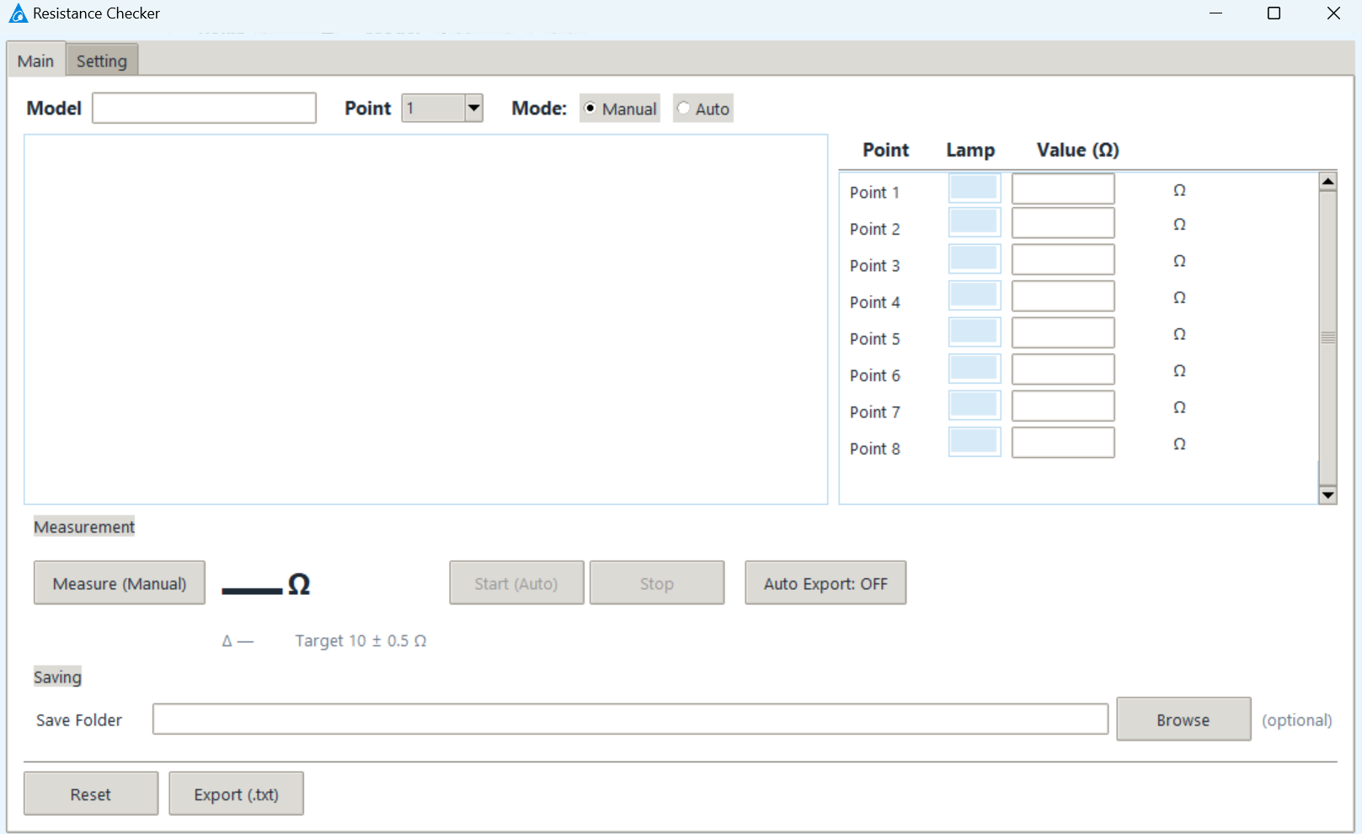
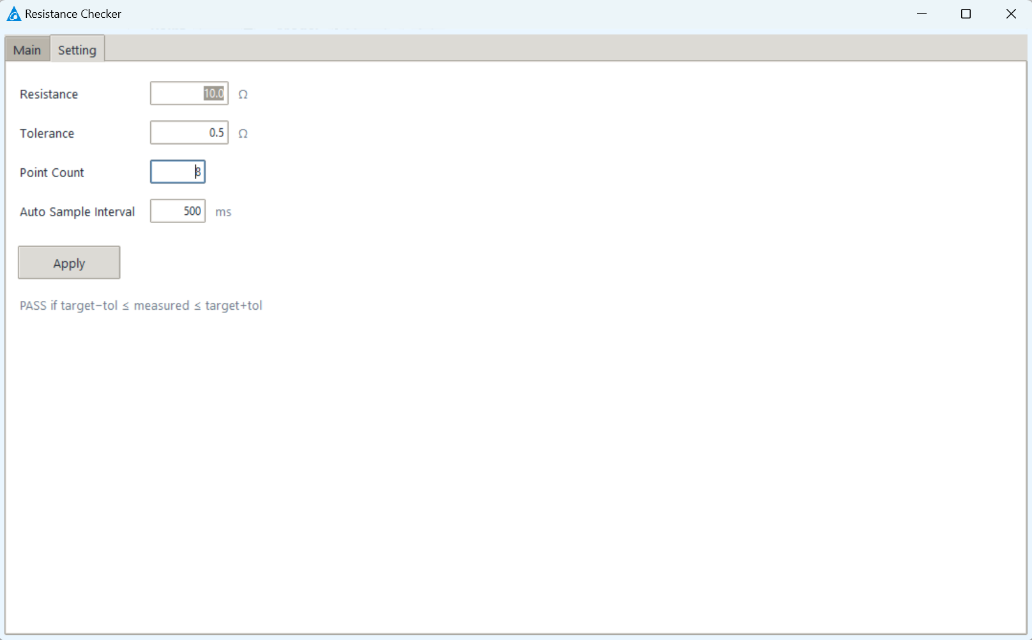
Example UI
Figure 3 : Example Main
Figure 4 : Example Setting

Slide 5
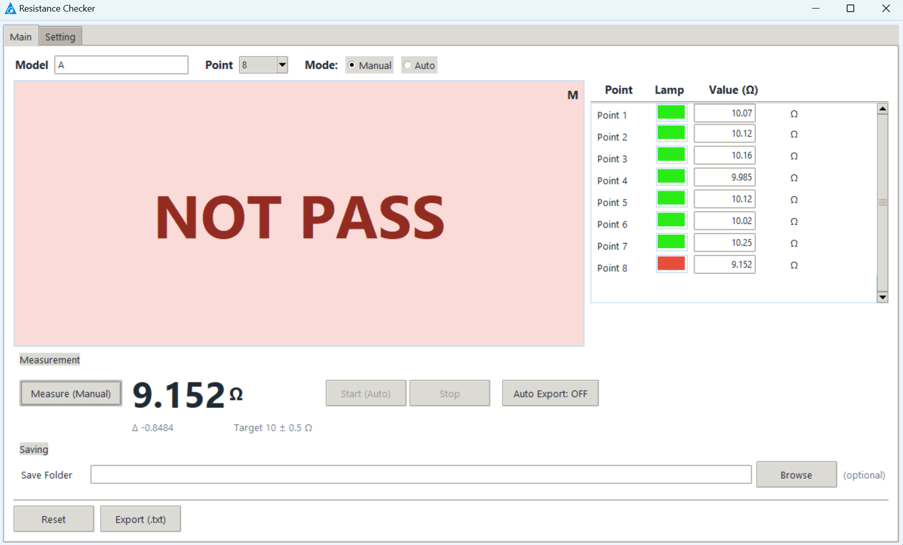
Main
Input model
Summary
Show result
Path file

Slide 6
Setting
Define resistance
Define tolerance
Define number of points

Slide 7
FLOW
TESTER
MEASURE
TRANSPORT DATA
RECEIVE DATA
EXPORT RESULT
ANALYZE & SUM

Slide 8
Smarter. Greener. Together.

